Slide 1








CHANDIGARH
UNIVERSITY
Discover. Lsam. Empower.
UNIVERSITY
RANKINGS
ftHSrr*WlcW MINISTRY OF EDUCATION
SHARI INDIA HACKATHQN
2023
BINARY THINKERS
Domain : Miscellaneous
PSID : SIH1366
Problem Statement Title :Centralized Nasha mukti kendra
Ministry/Organization Name :- MoSJE
Theme Name:- Miscellaneous

Slide 2




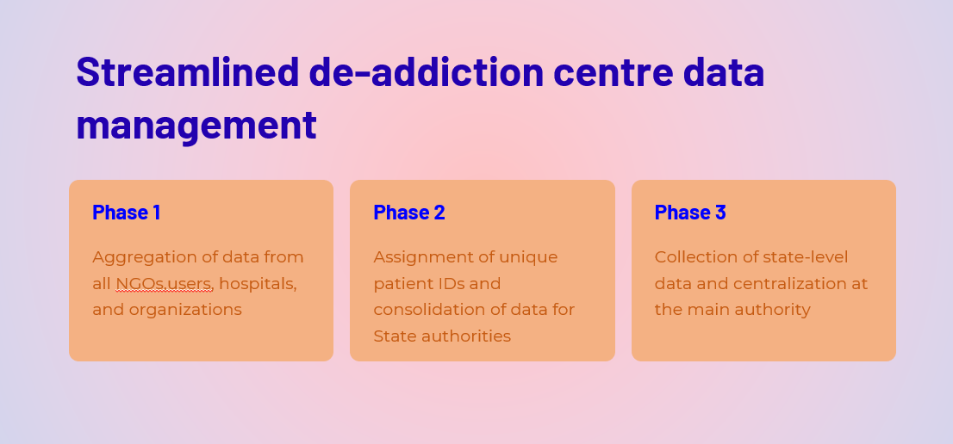
UNIVERSITY
RANKINGS
Idea/Approach Details
The Nasha Mukti Kendra Database aims to centralize data on de-addiction centers at the city, state, and national levels to enhance their effectiveness. This application will serve as an interface for monitoring counseling and de-addiction interventions. The application is structured in three phases. In the first phase, it will aggregate data from all NGOs, hospitals, and miscellaneous organizations. Subsequently, unique patient IDs will be assigned. In the second phase, the data will be consolidated and provided to state authorities. In the third phase, all state-level data will be collected and centralized at the main authority.
Technology Stack:- HTML, CSS, Node Js , Python and My SQL.
Use Cases
Data-driven decision making
Promotes data-driven decisions for mitigation
Enables collaboration among authorities for effective resolution
Increases awareness and drives acknowledgment of the crisis
Facilitates public transparency through a portal

Slide 3
